Slide 1

Company Bankruptcy Analysis
Huynh Kim Hung

Slide 2
Contents of this template
You can delete this slide when you’re done editing the presentation
Fonts | To view this template correctly in PowerPoint, download and install the fonts we used
Used and alternative resources | An assortment of graphic resources that are suitable for use in this presentation
Thanks slide | You must keep it so that proper credits for our design are given
Colors | All the colors used in this presentation
Icons and infographic resources | These can be used in the template, and their size and color can be edited
Editable presentation theme | You can edit the master slides easily. For more info, click here
For more info: SLIDESGO | BLOG | FAQs
You can visit our sister projects: FREEPIK | FLATICON | STORYSET | WEPIK | VIDEVO

Slide 3

Add a filter to the photos
If you want to apply the same filter as the pictures already included in the template, follow these instructions:
Insert the picture into the slide
Select the photo
Right-click and choose “Format options”
Open the “Recolor” tab and choose the color you need!

Slide 4
Table of contents
01
04
02
05
03
Project Goals
ML Model
Dataset Overview
Conclusion
EDA

Slide 5

01
Goals

Slide 6

Company Bankruptcy
Company bankruptcy happens when a company can't pay its debts, leading to asset liquidation to repay creditors and possibly halting operations.

Slide 7
Why study Historical Bankruptcy?
Risk Awareness
Industry Insight
Helps investors identify and reduce financial risks.
Reveals market trends and challenges for better business analysis.
Learning Opportunities
Strategic Guidance
Offers lessons to improve decision-making and avoid mistakes.
Provides struggling companies with strategies for recovery.

Slide 8
Project Goals
Purpose
Identify financial and operational factors that contribute to company bankruptcy.
Develop a predictive model to assess bankruptcy risk for companies.
Outcome
A machine learning model that accurately predicts bankruptcy.
Actionable insights into the financial indicators influencing a company's likelihood of bankruptcy.

Slide 9
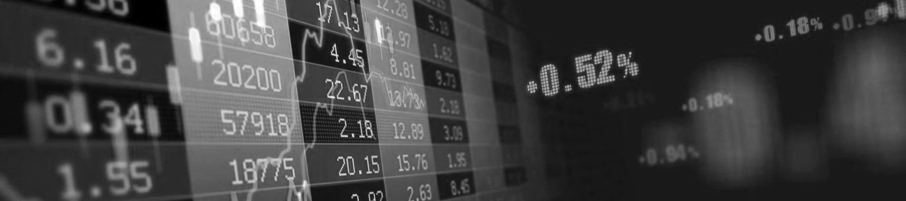
02
Dataset

Slide 10

The data were collected from the Taiwan Economic Journal for the years 1999 to 2009.
Company bankruptcy was defined based on the business regulations of the Taiwan Stock Exchange (TWSE).
Data collected includes company's bankrupted because of Dotcom Bubble (late 1990s and early 2000s) and Global Financial crisis (2007 - 2008).

Slide 11

The dataset includes the following columns:
Financial Indicators (95): Metrics such as total assets, liabilities, working capital, and revenue, etc.
Bankruptcy Status: Binary column indicating whether a company went bankrupt (1) or not (0).

Slide 12

03
EDA

Slide 13
Data Quality
Data dimension :
Number of Records : 6819
Number of Features : 96
Datatype of Features :
float64 93
int64 3
dtype: int64
Missing values :
Missing values not identified
Duplicated records :
Duplicated records not identified

Slide 14
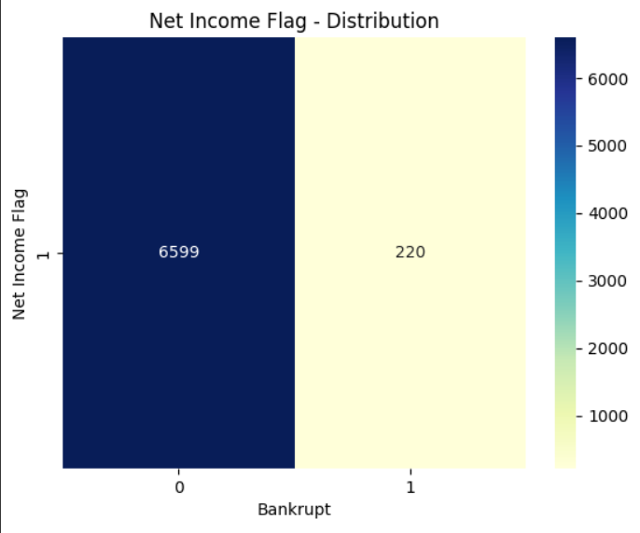
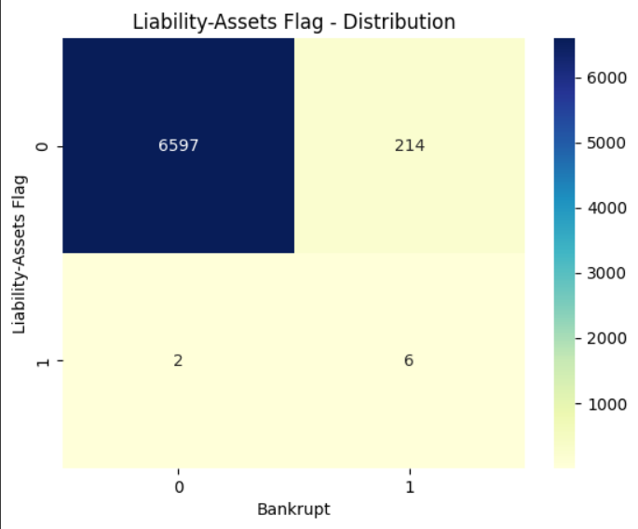
Categorical Columns Distribution
All the values in Net income flag are 1, so there is no use in retaining it in the model.
company_df.drop(['Net Income Flag'],axis = 1,inplace=True)

Slide 15
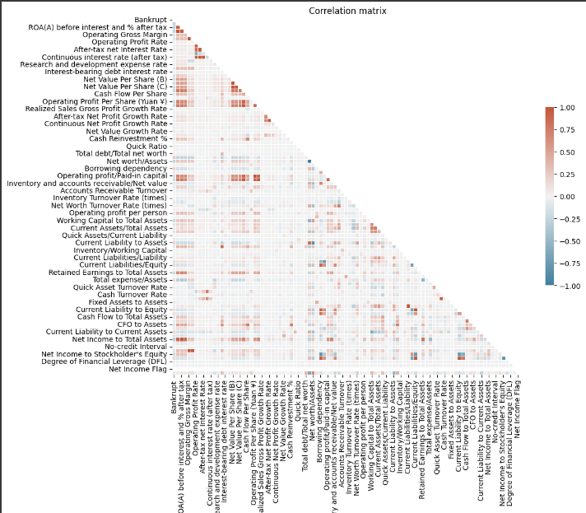
Correlation Analysis

Slide 16

Curse of Dimensionality
In the bankruptcy data we have has 90+ features. Analysing and building models using 90+ features is a time and resource consuming process.
Lets narrow down our analysis to limited columns, so we will use Predictive power score and Decision tree algorithm.

Slide 17
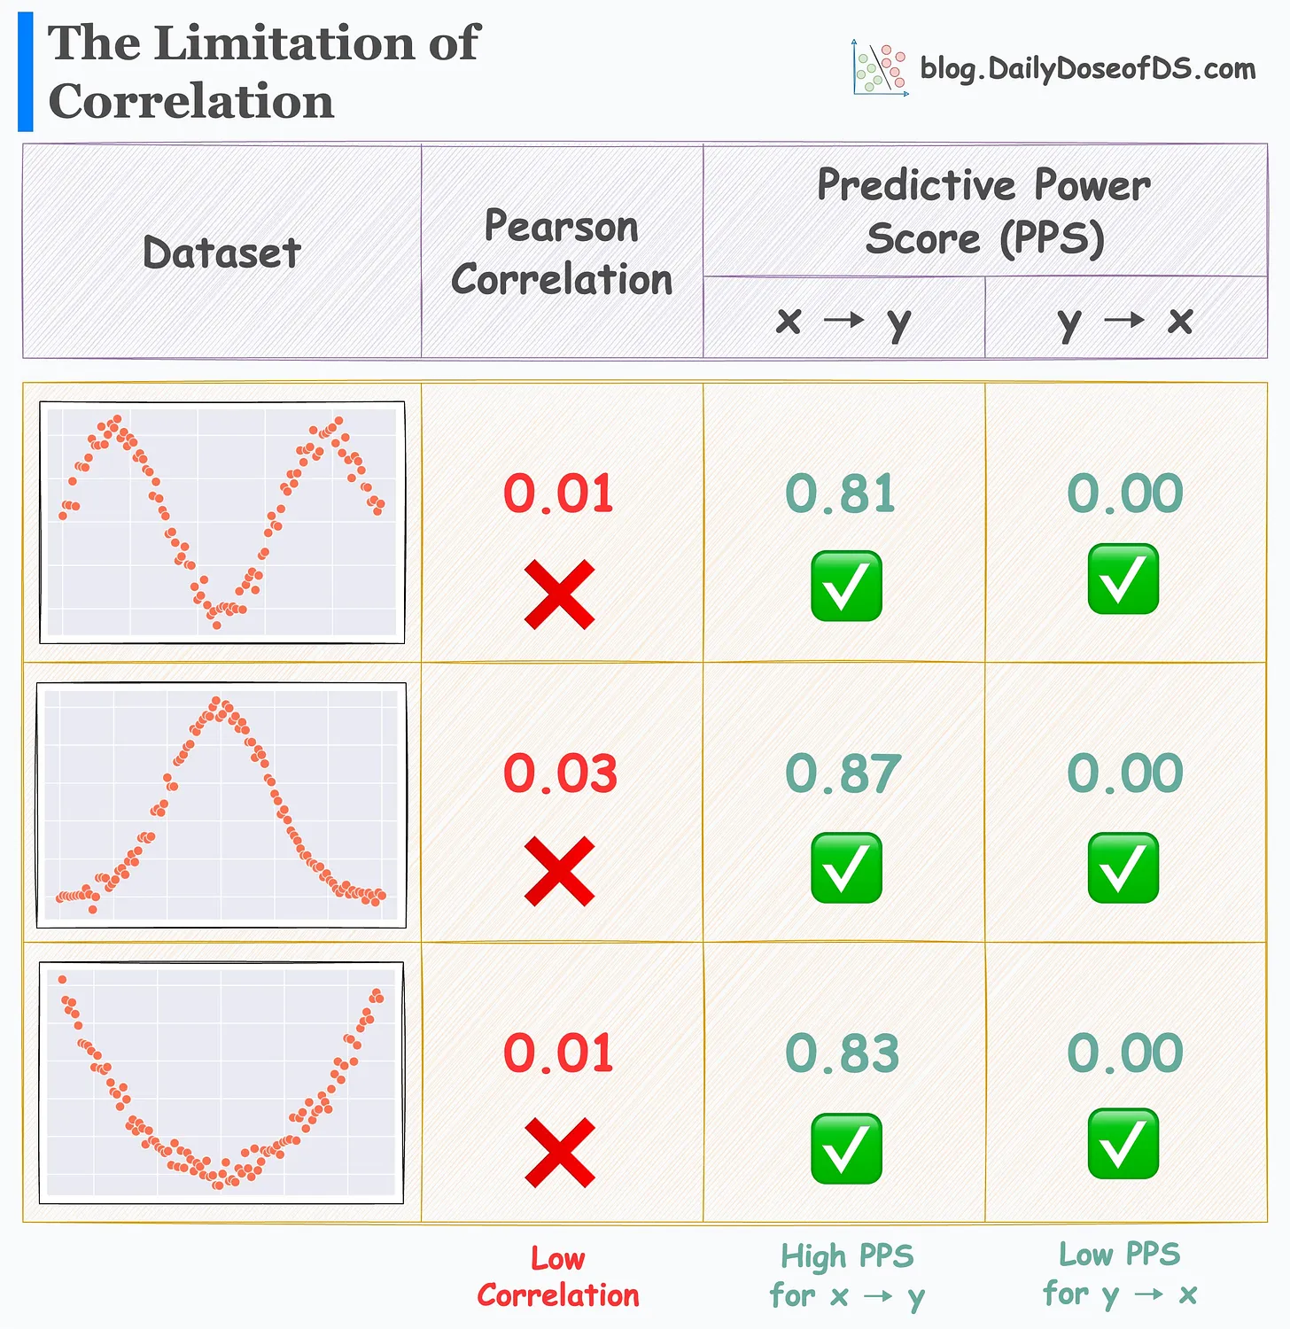
Predictive Power Score (PPS)
The PPS is an asymmetric, data-type-agnostic score that can detect linear or non-linear relationships between two columns.
The score ranges from 0 (no predictive power) to 1 (perfect predictive power). It can be used as an alternative to the correlation (matrix).
Objective :
To understand the Prediction power of each feature

Slide 18
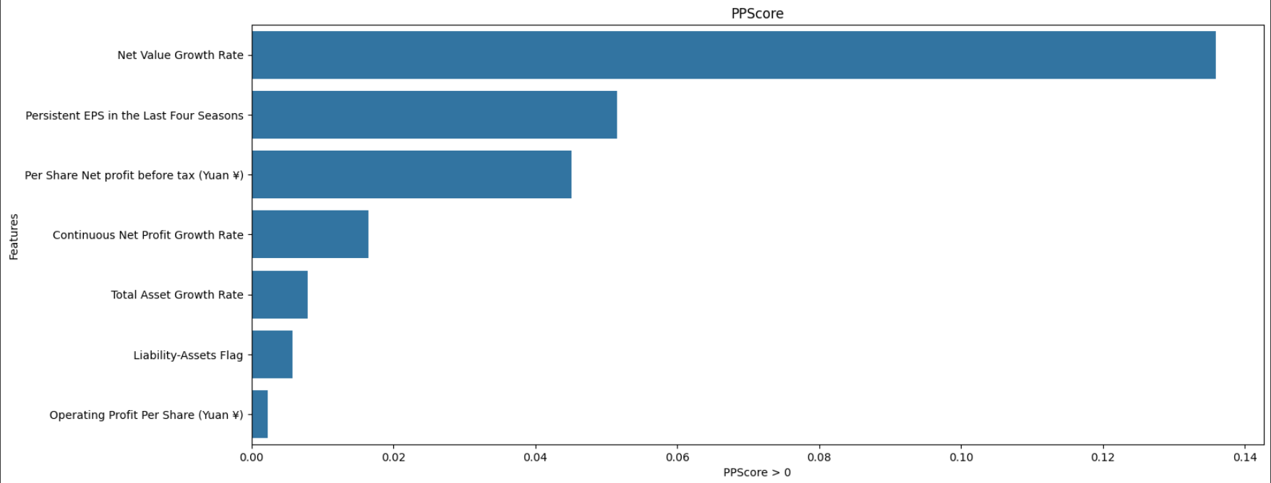
Predictive Power Score (PPS)

Slide 19
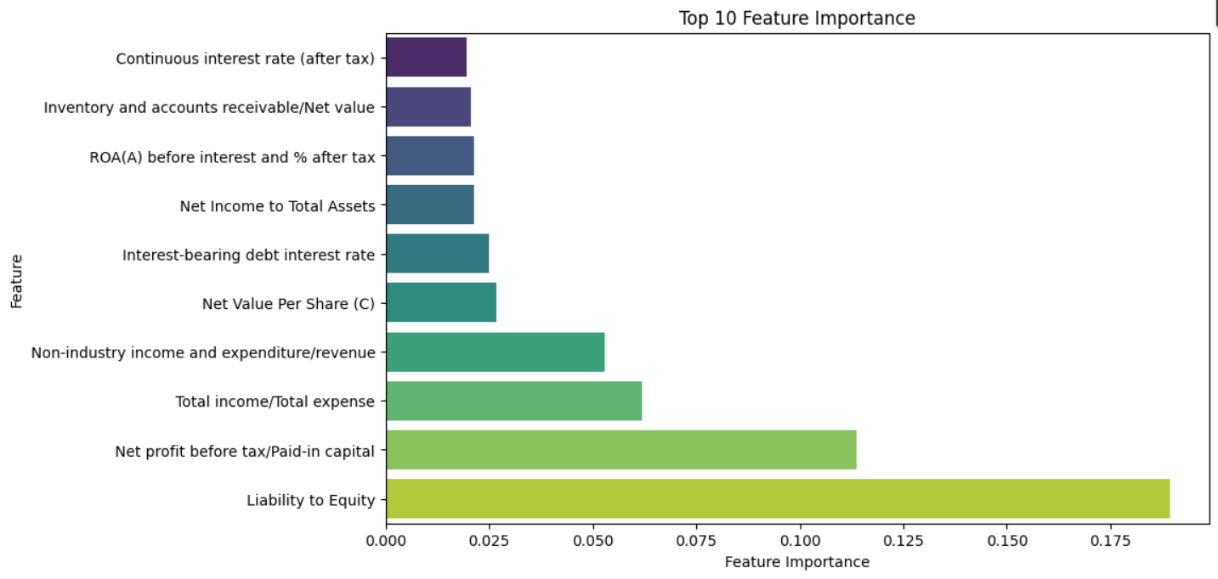
Decision Tree

Slide 20
Total Feature Selected
Selected features :
['Continuous Net Profit Growth Rate', 'Continuous interest rate (after tax)', 'Interest-bearing debt interest rate', 'Inventory and accounts receivable/Net value', 'Liability to Equity', 'Liability-Assets Flag', 'Net Income to Total Assets', 'Net Value Growth Rate', 'Net Value Per Share (C)', 'Net profit before tax/Paid-in capital', 'Non-industry income and expenditure/revenue', 'Operating Profit Per Share (Yuan ¥)', 'Per Share Net profit before tax (Yuan ¥)', 'Persistent EPS in the Last Four Seasons', 'ROA(A) before interest and % after tax', 'Total Asset Growth Rate', 'Total income/Total expense']
Number of features selected :
17

Slide 21
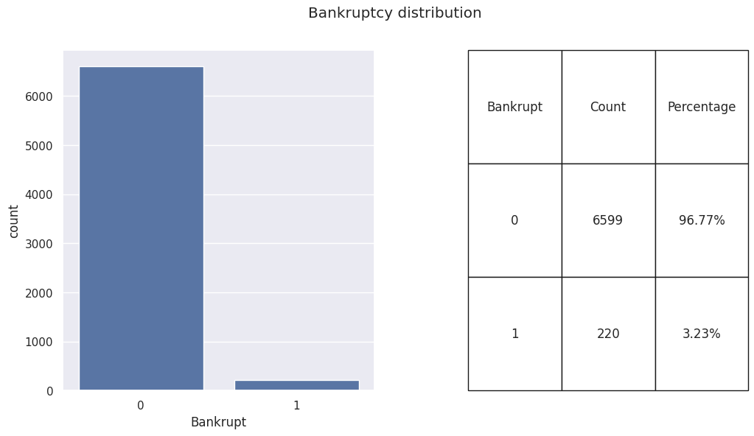
Bankruptcy Distribution

Slide 22
Handle Data Imbalance
1. Split the data into training and testing sets.
2. Set a sampling ratio between 0 and 1, increasing by 0.1 at each step. For each step:
- Select different sampling methods: Random Oversampler, SMOTE, ADASYN, SMOTEENN, SMOTETomek.
- Apply each algorithm to oversample the training data.
- Train a Decision Tree model and check its performance on the test data.
3. Choose the sampling method that gives the best overall results.

Slide 23
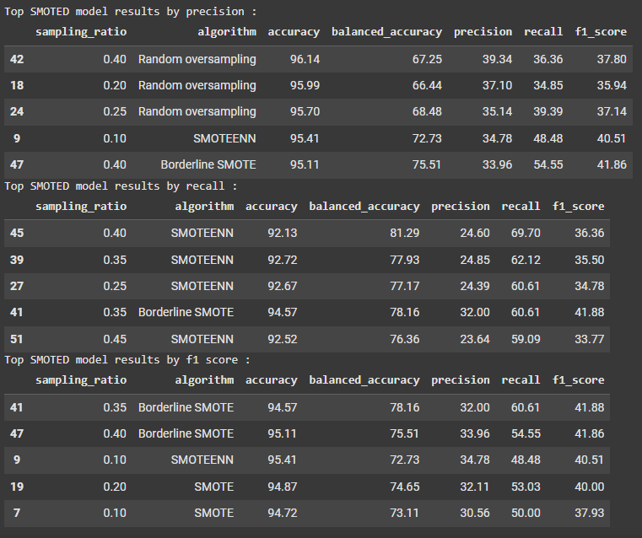
Handle Data Imbalance Result
- Models trained with oversampled (OS) data comfortably outperform the baseline model in terms of Recall, Precision, and F1 score.
- SMOTE ENN performs the best in terms of Recall.

Slide 24
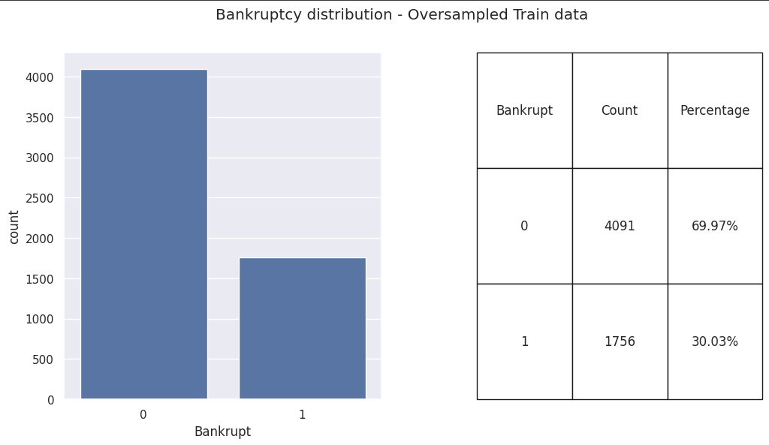
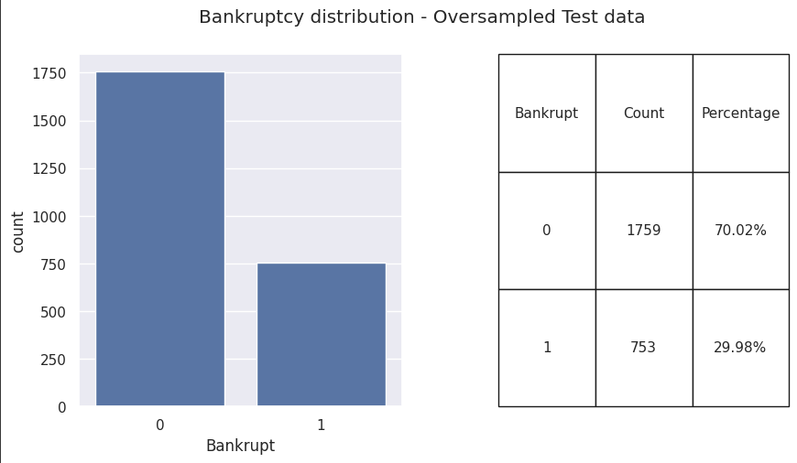
Bankruptcy Distribution

Slide 25
Bankruptcy Distribution

Slide 26

Outliers
In our dataset, only 3.23% of companies are bankrupt.
Bankruptcy is a rare occurrence in stable economic conditions and can be considered an outlier event.
Removing these outliers may result in the loss of valuable information. Therefore, we will retain all data points, including outliers.

Slide 27
04
ML Model

Slide 28
Find best ML Model
clf = LazyClassifier(verbose=0,ignore_warnings=True, custom_metric=None)
models,predictions = clf.fit(X_train_os, X_test_final, y_train_os, y_test_final)
models
Based on the result, we will choose LGBM Classifier, Random Forest and XGBoost for further analysis

Slide 29
Our evolution
2XXX
2XXX
2XXX
Birth
Development
Stabilisation
We had an idea, and we were ready to succeed
We faced challenges and grew as a company
Now we’re a reference in the market
2XXX
2XXX
2XXX
Broadening
Future
Horizon
We’re working on expanding to new markets
Here’s where we want to be in 5 years
Here are our goals for the distant future

Slide 30
Result
 |  |  | Random Forest | LGBM | XGBoost
Accuracy |  |  | 0.91 | 0.91 | 0.91
0 |  | Precision | 0.89 | 0.89 | 0.90
 |  | Recall | 0.98 | 0.98 | 0.98
 |  | F1 | 0.94 | 0.94 | 0.94
1 |  | Precision | 0.95 | 0.95 | 0.95
 |  | Recall | 0.72 | 0.73 | 0.74
 |  | F1 | 0.82 | 0.82 | 0.83

Slide 31
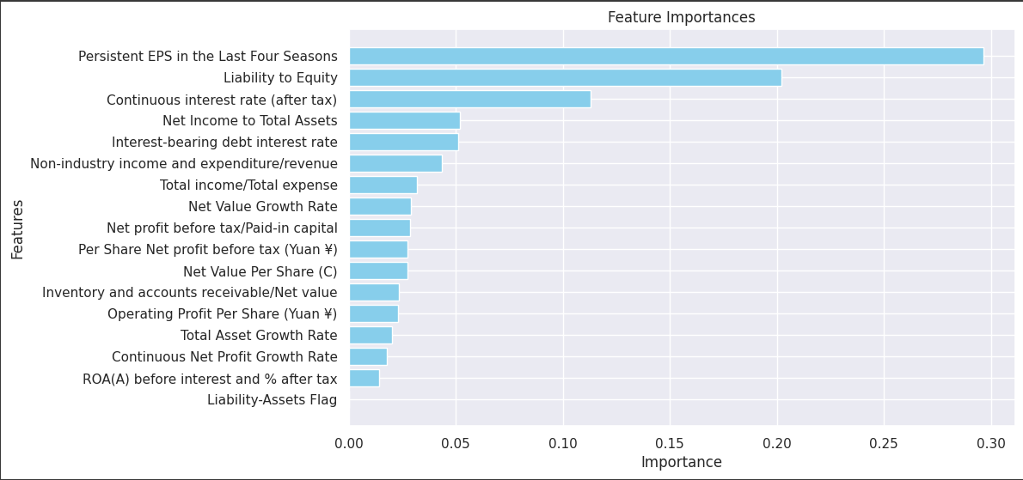
Result

Slide 32
05
Conclusion

Slide 33
Conclusion
Prioritize Persistent Earning-Per-Share (EPS)
Manage Liability to Equity Ratio
Monitor Interest Rate Exposure
Eliminating Liability-Assets Flag from reporting metrics

Slide 34

Thanks!
Do you have any questions?

